Slide 1
Concurrency Control

Slide 2
DBMS Concurrency Control Concurrency Control is the management procedure that is required for controlling concurrent execution of the operations that take place on a database. But before knowing about concurrency control, we should know about concurrent execution.

Slide 3
Concurrent Execution in DBMS
In a multi-user system, multiple users can access and use the same database at one time, which is known as the concurrent execution of the database. It means that the same database is executed simultaneously on a multi-user system by different users.
While working on the database transactions, there occurs the requirement of using the database by multiple users for performing different operations, and in that case, concurrent execution of the database is performed.
The thing is that the simultaneous execution that is performed should be done in an interleaved manner, and no operation should affect the other executing operations, thus maintaining the consistency of the database. Thus, on making the concurrent execution of the transaction operations, there occur several challenging problems that need to be solved.

Slide 4
Problems with Concurrent Execution
In a database transaction, the two main operations are READ and WRITE operations.
So, there is a need to manage these two operations in the concurrent execution of the transactions as if these operations are not performed in an interleaved manner, and the data may become inconsistent.
So, the following problems occur with the Concurrent Execution of the operations:

Slide 5
Problem 1: Lost Update Problems (W - W Conflict)
The problem occurs when two different database transactions perform the read/write operations on the same database items in an interleaved manner (i.e., concurrent execution) that makes the values of the items incorrect hence making the database inconsistent.
For example:
Consider the below diagram where two transactions T_{X} and T_{Y}, are performed on the same account A where the balance of account A is $300.

Slide 6
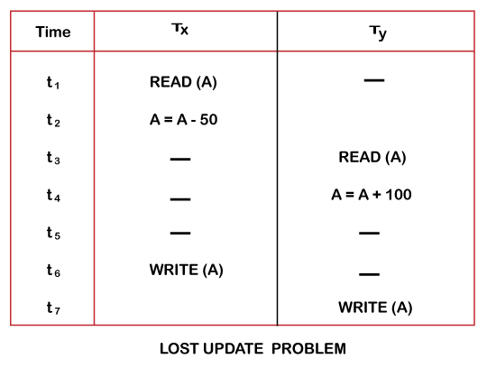

Slide 7
At time t1, transaction T_{X} reads the value of account A, i.e., $300 (only read).
At time t2, transaction T_{X} deducts $50 from account A that becomes $250 (only deducted and not updated/write).
Alternately, at time t3, transaction T_{Y} reads the value of account A that will be $300 only because T_{X} didn't update the value yet.
At time t4, transaction T_{Y} adds $100 to account A that becomes $400 (only added but not updated/write).
At time t6, transaction T_{X} writes the value of account A that will be updated as $250 only, as T_{Y} didn't update the value yet.
Similarly, at time t7, transaction T_{Y} writes the values of account A, so it will write as done at time t4 that will be $400. It means the value written by T_{X} is lost, i.e., $250 is lost.
Hence data becomes incorrect, and database sets to inconsistent.

Slide 8
Dirty Read Problems (W-R Conflict)
The dirty read problem occurs when one transaction updates an item of the database, and somehow the transaction fails, and before the data gets rollback, the updated database item is accessed by another transaction. There comes the Read-Write Conflict between both transactions.
For example:
Consider two transactions T_{X} and T_{Y} in the below diagram performing read/write operations on account A where the available balance in account A is $300:

Slide 9
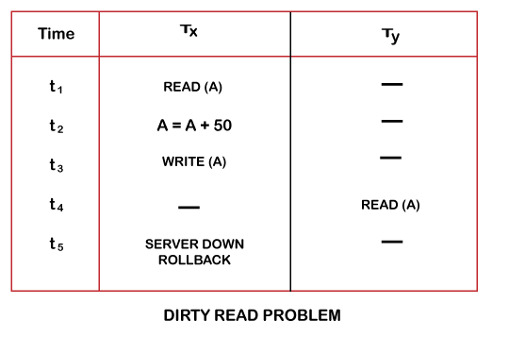

Slide 10
At time t1, transaction T_{X} reads the value of account A, i.e., $300.
At time t2, transaction T_{X} adds $50 to account A that becomes $350.
At time t3, transaction T_{X} writes the updated value in account A, i.e., $350.
Then at time t4, transaction T_{Y} reads account A that will be read as $350.
Then at time t5, transaction T_{X} rollbacks due to server problem, and the value changes back to $300 (as initially).
But the value for account A remains $350 for transaction T_{Y} as committed, which is the dirty read and therefore known as the Dirty Read Problem.

Slide 11
Unrepeatable Read Problem (W-R Conflict)
Also known as Inconsistent Retrievals Problem that occurs when in a transaction, two different values are read for the same database item.
For example:
Consider two transactions, T_{X} and T_{Y}, performing the read/write operations on account A, having an available balance = $300. The diagram is shown below:

Slide 12
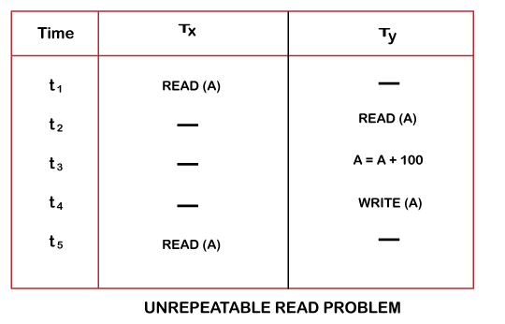

Slide 13
At time t1, transaction T_{X} reads the value from account A, i.e., $300.
At time t2, transaction T_{Y} reads the value from account A, i.e., $300.
At time t3, transaction T_{Y} updates the value of account A by adding $100 to the available balance, and then it becomes $400.
At time t4, transaction T_{Y} writes the updated value, i.e., $400.
After that, at time t5, transaction T_{X} reads the available value of account A, and that will be read as $400.
It means that within the same transaction T_{X}, it reads two different values of account A, i.e., $ 300 initially, and after updation made by transaction T_{Y}, it reads $400. It is an unrepeatable read and is therefore known as the Unrepeatable read problem.
Thus, in order to maintain consistency in the database and avoid such problems that take place in concurrent execution, management is needed, and that is where the concept of Concurrency Control comes into role.

Slide 14
What is Serializability in DBMS?
In the field of computer science, serializability is a term that is a property of the system that describes how the different process operates the shared data.
If the result given by the system is similar to the operation performed by the system, then in this situation, we call that system serializable.
Here the cooperation of the system means there is no overlapping in the execution of the data.
In DBMS, when the data is being written or read then, the DBMS can stop all the other processes from accessing the data.

Slide 15
What is a Serializable Schedule?
In a database management system (DBMS), a serializable schedule is a sequence of database actions (read and write operations) that does not violate the serializability property.
This property ensures that each transaction appears to execute atomically and is isolated from other transactions' effects.
In order for serializability of schedules in DBMS, it must be equivalent to some serial schedule of the same transactions.
In other words, the schedule must produce the same results as if the transactions were executed one at a time in some order.

Slide 16
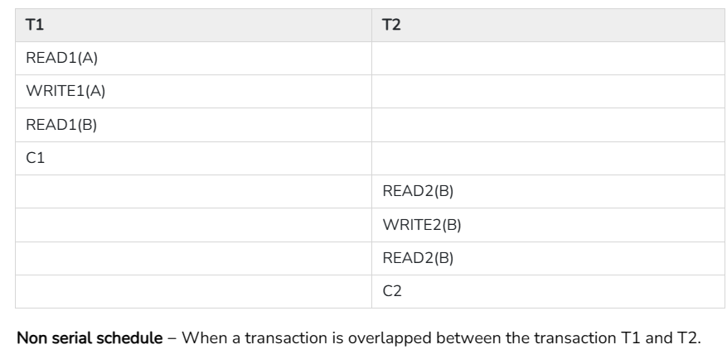
A schedule is serialized if it is equivalent to a serial schedule. A concurrent schedule must ensure it is the same as if executed serially means one after another. It refers to the sequence of actions such as read, write, abort, commit are performed in a serial manner.
Example- Let’s take two transactions T1 and T2,
If both transactions are performed without interfering each other then it is called as serial schedule, it can be represented as follows −

Slide 17
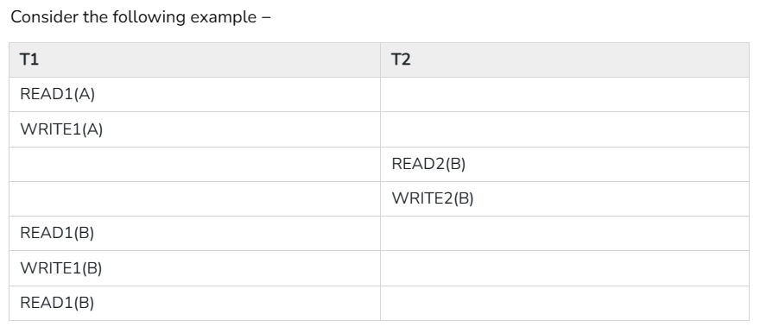

Slide 18

Types of Serializability
In a database management system (DBMS), serializability requires that transactions appear to happen in a particular order, even if they execute concurrently.
Transactions that are not serializable may produce incorrect results.
Here, we'll look closely at two of the most common types: conflict serializability and view serializability in DBMS.

Slide 19
1. Conflict Serializability
Conflict serializability is a type of serializability in which conflicting operations on the same data items are executed in an order that preserves database consistency.
Each transaction is assigned a unique number, and the operations within each transaction are executed in order based on that number. This ensures that no two conflicting operations are executed concurrently.
For example, consider a database with two tables: Customers and Orders. A customer can have multiple orders, but each order can only be associated with one customer.

Slide 20
Key conditions for conflict serializability.
Both operations belong to different transactions
Both operations are on the same data item
At least one of the two operations is a write operation
If two transactions were to execute concurrently, one adding an order for customer A and the other adding an order for customer B, conflict serializability would ensure that the transaction adding the order for customer A would finish before the transaction adding the order for customer B. This would prevent any inconsistency in the database, such as an order being associated with the wrong customer.

Slide 21
It orders any conflicting operations in the same way as some serial execution. A pair of operations is said to conflict if they operate on the same data item and one of them is a write operation.
That means
Readi(x) readj(x) - non conflict read-read operation
Readi(x) writej(x) - conflict read-write operation.
Writei(x) readj(x) - conflict write-read operation.
Writei(x) writej(x) - conflict write-write operation.

Slide 22
2. View Serializability
View serializability is a type of serializability in which each transaction produces results that are equivalent to some well-defined sequential execution of all transactions in the system.
Unlike conflict serializability, which focuses on preventing inconsistencies within the database, view serializability in DBMS focuses on providing users with consistent views of the database.

Slide 23
The rules it follows are as follows −
T1 is reading the initial value of A, then T2 also reads the initial value of A.
T1 is the reading value written by T2, then T2 also reads the value written by T1.
T1 is writing the final value, and then T2 also has the write operation as the final value.

